Slide 1
Java JDBC :
JDBC stands for Java Database Connectivity. JDBC is a Java API to connect and execute the query with the database. JDBC API uses JDBC drivers to connect with the database.
We can use JDBC API to access tabular data stored in any relational database. By the help of JDBC API, we can save, update, delete and fetch data from the database. It is like Open Database Connectivity (ODBC) provided by Microsoft.
Why Should We Use JDBC :
Before JDBC, ODBC API was the database API to connect and execute the query with the database. But, ODBC API uses ODBC driver which is written in C language (i.e. platform dependent and unsecured). That is why Java has defined its own API (JDBC API) that uses JDBC drivers (written in Java language).
We can use JDBC API to handle database using Java program and can perform the following activities:
Connect to the database
Execute queries and update statements to the database
Retrieve the result received from the database.

Slide 2
JDBC Driver :
JDBC Driver is a software component that enables java application to interact with the database.
There are 4 types of JDBC drivers:
JDBC-ODBC bridge driver
Native-API driver (partially java driver)
Network Protocol driver (fully java driver)
Thin driver (fully java driver)

Slide 3
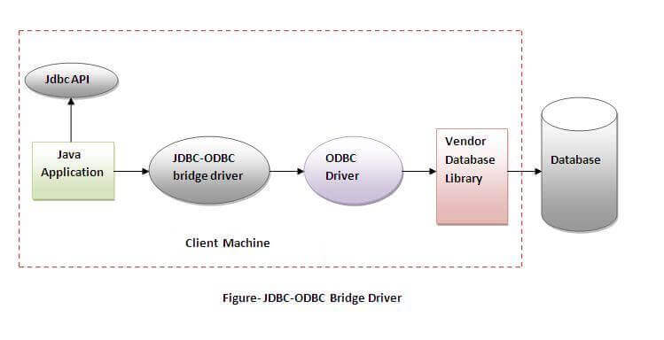
1) JDBC-ODBC bridge driver :
The JDBC-ODBC bridge driver uses ODBC driver to connect to the database. The JDBC-ODBC bridge driver converts JDBC method calls into the ODBC function calls. This is now discouraged because of thin driver.
Advantages:
easy to use.
can be easily connected to any database.
Disadvantages:
Performance degraded because JDBC method call is converted into the ODBC function calls.
The ODBC driver needs to be installed on the client machine.

Slide 4
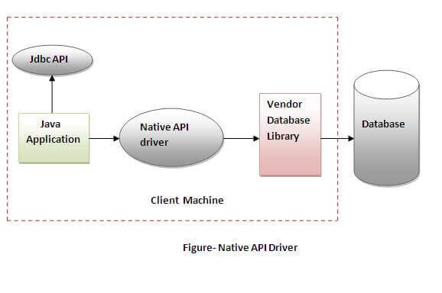
2) Native-API driver :
The Native API driver uses the client-side libraries of the database. The driver converts JDBC method calls into native calls of the database API. It is not written entirely in java.
Advantage:
performance upgraded than JDBC-ODBC bridge driver.
Disadvantage:
The Native driver needs to be installed on the each client machine.
The Vendor client library needs to be installed on client machine.

Slide 5
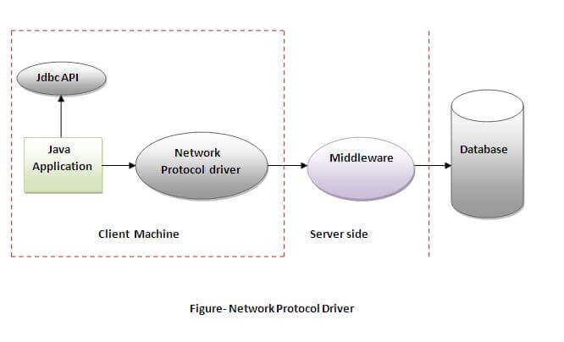
3) Network Protocol driver :
The Network Protocol driver uses middleware (application server) that converts JDBC calls directly or indirectly into the vendor-specific database protocol. It is fully written in java.
Advantage:
No client side library is required because of application server that can perform many tasks like auditing, load balancing, logging etc.
Disadvantages:
Network support is required on client machine.
Requires database-specific coding to be done in the middle tier.
Maintenance of Network Protocol driver becomes costly because it requires database-specific coding to be done in the middle tier.

Slide 6
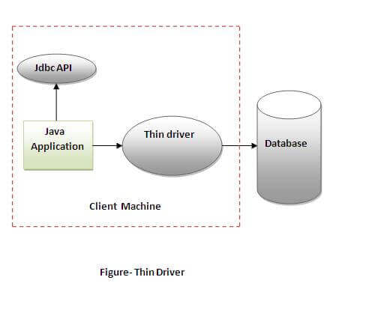
4) Thin driver :
The thin driver converts JDBC calls directly into the vendor-specific database protocol. That is why it is known as thin driver. It is fully written in Java language.
Advantage:
Better performance than all other drivers.
No software is required at client side or server side.
Disadvantage:
Drivers depend on the Database.

Slide 7
Java Database Connectivity Steps :
There are 5 steps to connect any java application with the database using JDBC.
Register the Driver class
Create connection
Create statement
Execute queries
Close connection
Register the driver class :
The forName() method of Class is used to register the driver class. This method is used to dynamically load the driver class.
Syntax of forName() method
public static void forName(String className)throws ClassNotFoundException
2) Create the connection object
The getConnection() method of DriverManager class is used to establish connection with the database.
Syntax of getConnection() method
public static Connection getConnection(String url,String name,String password)
throws SQLException

Slide 8
3) Create the Statement object :
The createStatement() method of Connection interface is used to create statement. The object of statement is responsible to execute queries with the database.
syntax of createStatement() method :
public Statement createStatement()throws SQLException
create the statement object
Statement st=con.createStatement();
4) Execute the query
The executeQuery() method of Statement interface is used to execute queries to the database. This method returns the object of ResultSet that can be used to get all the records of a table.
Syntax of executeQuery() method
public ResultSet executeQuery(String sql)throws SQLException
Example to execute query
ResultSet rs=stmt.executeQuery("select * from emp");
while(rs.next()){
System.out.println(rs.getInt(1)+" "+rs.getString(2));
}

Slide 9
5) Close the connection object :
By closing connection object statement and ResultSet will be closed automatically. The close() method of Connection interface is used to close the connection.
Example to close connection
con.close();

Slide 10
Java Database Connectivity with MySQL :
To connect Java application with the MySQL database, we need to follow following steps.
Driver class: The driver class for the mysql database is com.mysql.jdbc.Driver.
Connection URL:
The connection URL for the mysql database is jdbc:mysql://localhost:3306/sonoo
where jdbc is the API, mysql is the database, localhost is the server name on which mysql is running, we may also use IP address, 3306 is the port number and sonoo is the database name.
Username: The default username for the mysql database is root.
Password: It is the password given by the user at the time of installing the mysql database.

Slide 11
DriverManager class :
The DriverManager class acts as an interface between user and drivers.
It keeps track of the drivers that are available and handles establishing a connection between a database and the appropriate driver.
Useful methods of DriverManager class
Method | Description
1) public static void registerDriver(Driver driver): | is used to register the given driver with DriverManager.
2) public static void deregisterDriver(Driver driver): | is used to deregister the given driver (drop the driver from the list) with DriverManager.
3) public static Connection getConnection(String url): | is used to establish the connection with the specified url.
4) public static Connection getConnection(String url,String userName,String password): | is used to establish the connection with the specified url, username and password.

Slide 12
Connection interface :
A Connection is the session between java application and database.
The Connection interface provide many methods for transaction management like commit(), rollback() etc.
Commonly used methods of Connection interface:
1) public Statement createStatement(): creates a statement object that can be used to execute SQL queries.
2) public Statement createStatement(int resultSetType,int resultSetConcurrency): Creates a Statement object that will generate ResultSet objects with the given type and concurrency.
3) public void setAutoCommit(boolean status): is used to set the commit status.By default it is true.
4) public void commit(): saves the changes made since the previous commit/rollback permanent.
5) public void rollback(): Drops all changes made since the previous commit/rollback.
6) public void close(): closes the connection and Releases a JDBC resources immediately.

Slide 13
Statement interface :
The Statement interface provides methods to execute queries with the database.
Commonly used methods of Statement interface:
public ResultSet executeQuery(String sql): is used to execute SELECT query. It returns the object of ResultSet.
2) public int executeUpdate(String sql): is used to execute specified query, it may be create, drop, insert, update, delete etc.
3) public boolean execute(String sql): is used to execute queries that may return multiple results.
4) public int[] executeBatch(): is used to execute batch of commands.

Slide 14
Statement interface :
Once a connection is obtained we can interact with the database. The JDBC Statement, CallableStatement, and PreparedStatement interfaces define the methods and properties that enable you to send SQL or PL/SQL commands and receive data from your database.
Interfaces | Recommended Use
Statement | Use this for general-purpose access to your database. Useful when you are using static SQL statements at runtime. The Statement interface cannot accept parameters.
PreparedStatement | Use this when you plan to use the SQL statements many times. The PreparedStatement interface accepts input parameters at runtime.
CallableStatement | Use this when you want to access the database stored procedures. The CallableStatement interface can also accept runtime input and output parameters.
All parameters in JDBC are represented by the ? symbol, which is known as the parameter marker. You must supply values for every parameter before executing the SQL statement.
The setXXX() methods bind values to the parameters, where XXX represents the Java data type of the value you wish to bind to the input parameter. If you forget to supply the values, you will receive an SQLException.

Slide 15
Three types of parameters exist: IN, OUT, and INOUT. The PreparedStatement object only uses the IN parameter. The CallableStatement object can use all the three.
Parameter | Description
IN | A parameter whose value is unknown when the SQL statement is created. You bind values to IN parameters with the setXXX() methods.
OUT | A parameter whose value is supplied by the SQL statement it returns. You retrieve values from the OUT parameters with the getXXX() methods.
INOUT | A parameter that provides both input and output values. You bind variables with the setXXX() methods and retrieve values with the getXXX() methods.

Slide 16
ResultSet interface :
The object of ResultSet maintains a cursor pointing to a row of a table. Initially, cursor points to before the first row.
By default, ResultSet object can be moved forward only and it is not updatable.
But we can make this object to move forward and backward direction by passing either TYPE_SCROLL_INSENSITIVE or TYPE_SCROLL_SENSITIVE in createStatement(int,int) method as well as we can make this object as updatable by:
Statement stmt = con.createStatement(ResultSet.TYPE_SCROLL_INSENSITIVE, ResultSet.CONCUR_UPDATABLE);

Slide 17
Commonly used methods of ResultSet interface :
1) public boolean next(): | is used to move the cursor to the one row next from the current position.
2) public boolean previous(): | is used to move the cursor to the one row previous from the current position.
3) public boolean first(): | is used to move the cursor to the first row in result set object.
4) public boolean last(): | is used to move the cursor to the last row in result set object.
5) public boolean absolute(int row): | is used to move the cursor to the specified row number in the ResultSet object.
6) public boolean relative(int row): | is used to move the cursor to the relative row number in the ResultSet object, it may be positive or negative.
7) public int getInt(int columnIndex): | is used to return the data of specified column index of the current row as int.
8) public int getInt(String columnName): | is used to return the data of specified column name of the current row as int.
9) public String getString(int columnIndex): | is used to return the data of specified column index of the current row as String.
10) public String getString(String columnName): | is used to return the data of specified column name of the current row as String.

Slide 18
Java ResultSetMetaData Interface :
The metadata means data about data i.e. we can get further information from the data.
ResultSetMetaData interface is useful because it provides methods to get metadata from the ResultSet object like total number of column, column name, column type etc.
Commonly used methods of ResultSetMetaData interface
Method | Description
public int getColumnCount() | it returns the total number of columns in the ResultSet object.
public String getColumnName(int index) | it returns the column name of the specified column index.
public String getColumnTypeName(int index) | it returns the column type name for the specified index.
public String getTableName(int index) | it returns the table name for the specified column index.

Slide 19
Java DatabaseMetaData interface :
DatabaseMetaData interface provides methods to get meta data of a database such as database product name, database product version, driver name, name of total number of tables, name of total number of views etc.
Commonly used methods of DatabaseMetaData interface
public String getDriverName()throws SQLException: it returns the name of the JDBC driver.
public String getDriverVersion()throws SQLException: it returns the version number of the JDBC driver.
public String getUserName()throws SQLException: it returns the username of the database.
public String getDatabaseProductName()throws SQLException: it returns the product name of the database.
public String getDatabaseProductVersion()throws SQLException: it returns the product version of the database.
public ResultSet getTables(String catalog, String schemaPattern, String tableNamePattern, String[] types)throws SQLException: it returns the description of the tables of the specified catalog. The table type can be TABLE, VIEW, ALIAS, SYSTEM TABLE, SYNONYM etc.

Slide 20
Transaction Management in JDBC :
Transaction represents a single unit of work.
The ACID properties describes the transaction management well. ACID stands for Atomicity, Consistency, isolation and durability.
Atomicity means either all successful or none.
Consistency ensures bringing the database from one consistent state to another consistent state.
Isolation ensures that transaction is isolated from other transaction.
Durability means once a transaction has been committed, it will remain so, even in the event of errors, power loss etc.
Advantage of Transaction Management
fast performance It makes the performance fast because database is hit at the time of commit.

Slide 21
In JDBC, Connection interface provides methods to manage transaction
Method | Description
void setAutoCommit(boolean status) | It is true bydefault means each transaction is committed bydefault.
void commit() | commits the transaction.
void rollback() | cancels the transaction.

Slide 22
Batch Processing in JDBC :
Instead of executing a single query, we can execute a batch (group) of queries. It makes the performance fast.
Advantage of Batch Processing
Fast Performance
Batch processing in jdbc steps :
Load the driver class
Create Connection
Create Statement
Add query in the batch
Execute Batch
Close Connection

Slide 23
Methods of Statement interface
Method | Description
void addBatch(String query) | It adds query into batch.
int[] executeBatch() | It executes the batch of queries.

